Slide 1
ROBOT BASED AUTOMATION FOR VERTICAL FARMING
- MAJOR PROJECT

Slide 2
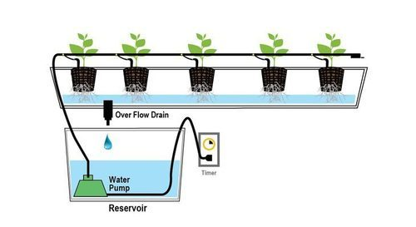
OVER VIEW

Slide 3
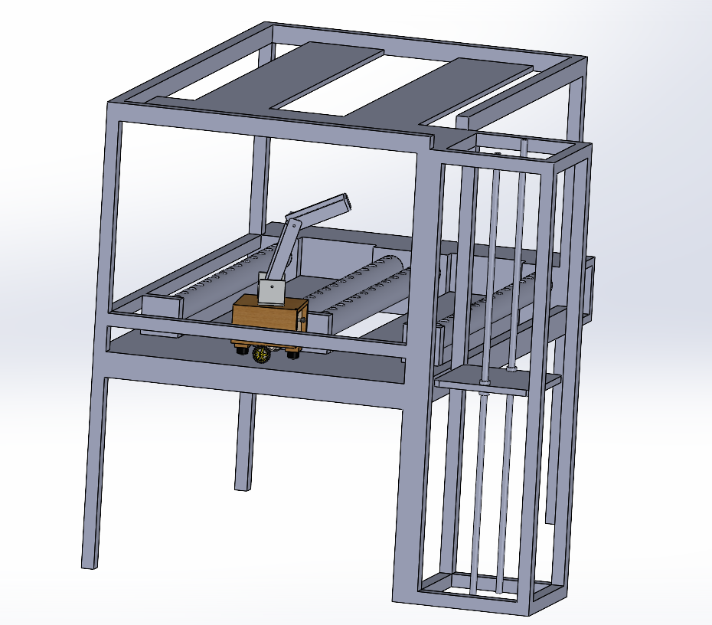
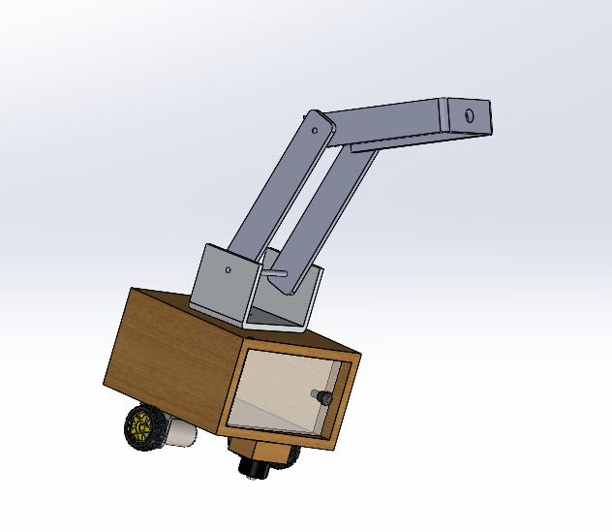
CAD
MANIPULATOR

Slide 4
PLANTS
Tomato
Radish
Capsicum
Beans
Spinach
Mint
Leafy vegetables

Slide 5
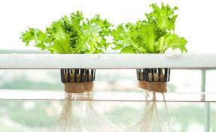
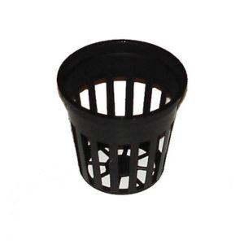
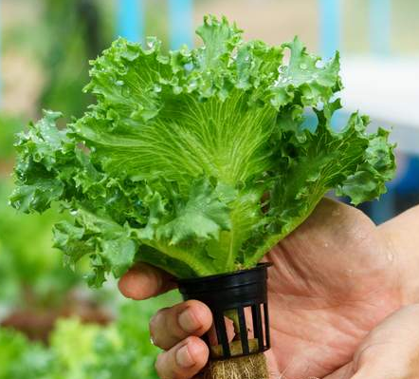
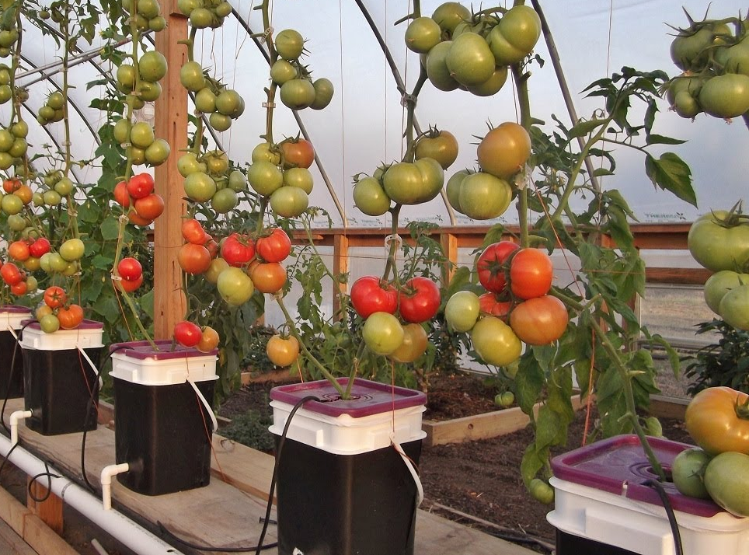
END EFFECTOR
Tasks
Planting
Harvesting
Net Pots
Leafy Vegetables
Vegetables

Slide 6
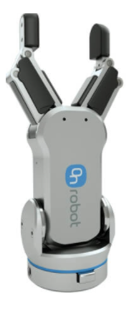
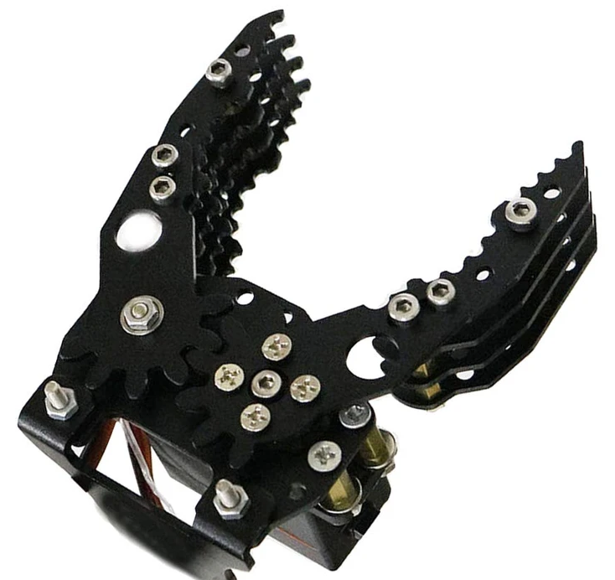
GRIPPER

Slide 7
LIFT
Lead Screw
Pulley belt drive

